Slide 1
K8C
Resources and microservices

Slide 2
Product description
The product is a platform for deploying, managing, and scaling machine learning models in production. It offers a secure, flexible environment for automating ML tasks like model versioning, routing, and monitoring. With Kubernetes integration and containerization support, it's designed for developers, ML engineers, and enterprises needing scalable, reliable ML infrastructure.
Team K8C: Tsurkan Daniel; Dandamaev Gadji; Tsaturyan Konstantin; Smolkin Mikhail
Project repo: https://github.com/fanglores/Advanced-Software-Design
This report: https://github.com/fanglores/Advanced-Software-Design /blob/master/Practice%20Tasks/Module2/Task9/task9.1.pptx

Slide 3
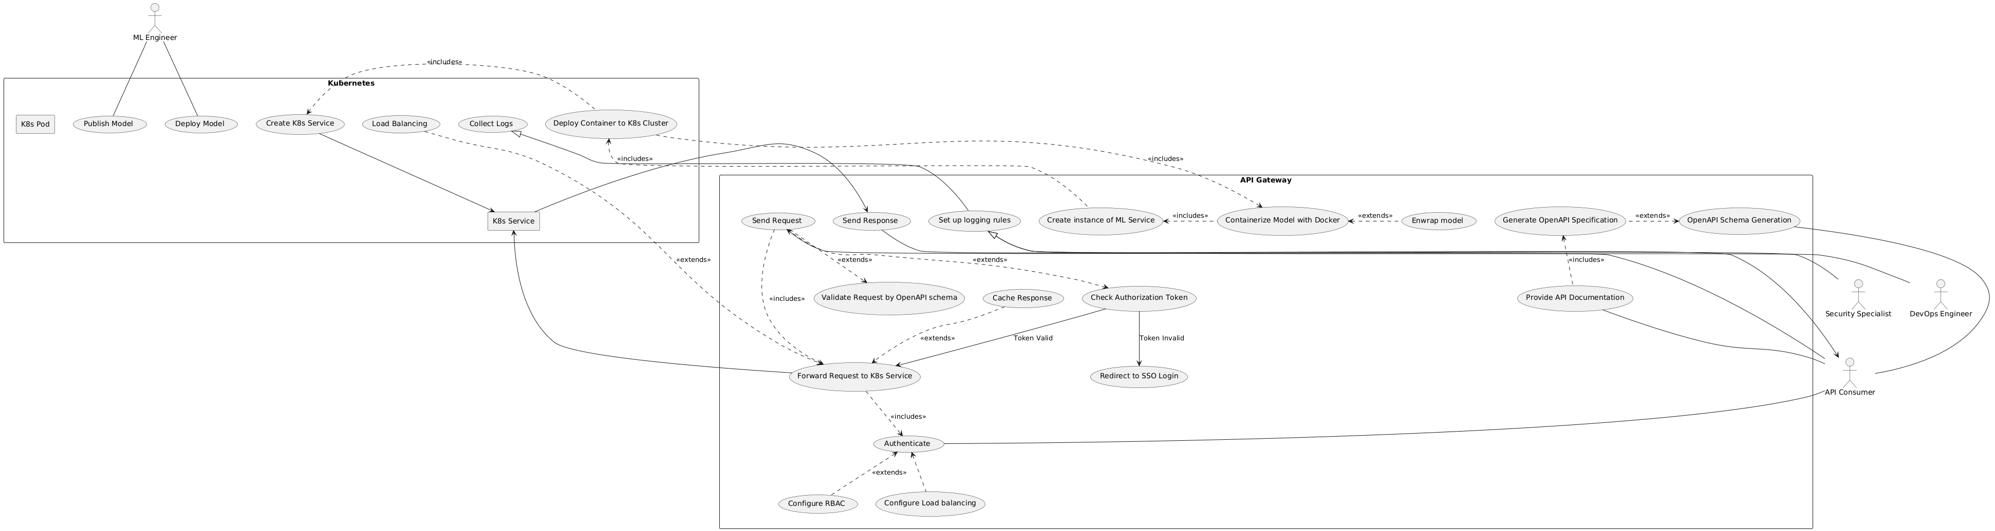
Use case diagram
https://github.com/fanglores/Advanced-Software-Design/tree/master/General/UseCases

Slide 4
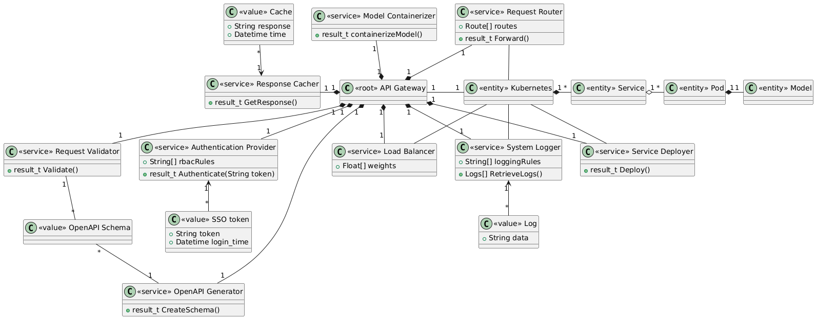
HIDDEN

Slide 5
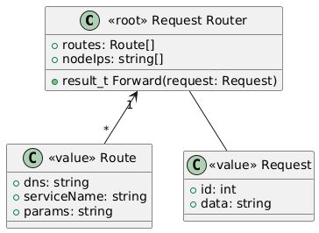
Request Router Aggregation
stores
receives

Slide 6
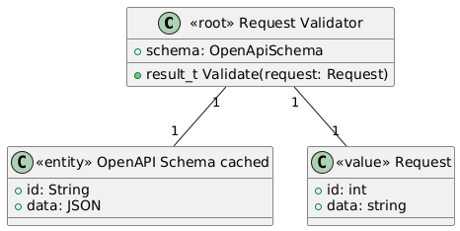
Request Validator Aggregation
stores
validates

Slide 7
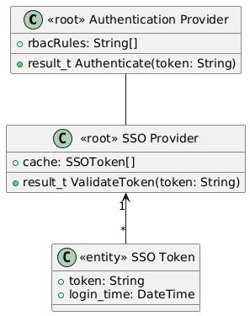
Authentication Provider Aggregation

Slide 8
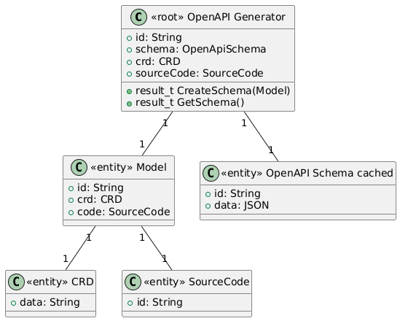
OpenAPI Generator Aggregation
receives
generates, stores
has
has

Slide 9
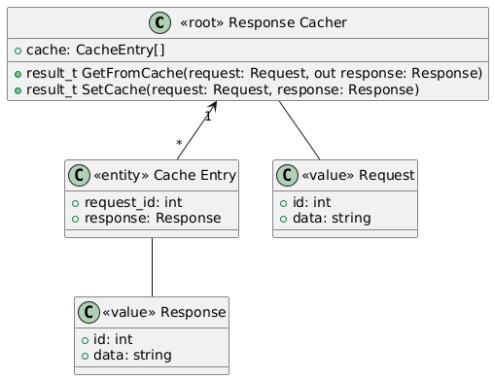
Response Cacher Aggregation
stores
receives
has

Slide 10
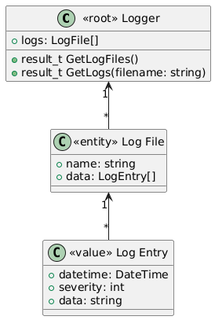
Logger Aggregation
has
consists of

Slide 11
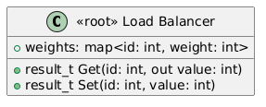
Load Balancer Aggregation

Slide 12
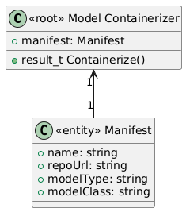
Model Containerizer Aggregation
has

Slide 13
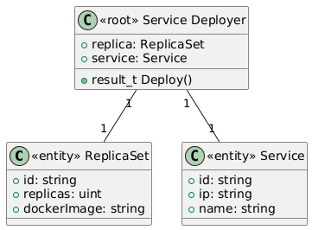
Service Deployer Aggregation
has
has

Slide 14
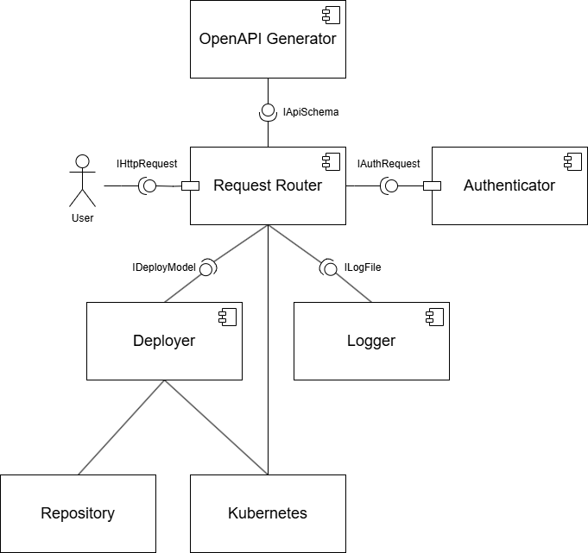
Service diagram

Slide 15
Traceability
Microservice (component) | Resources (provided interfaces) | Domain classes in the microservice | Use case that use the microservice
Request Router | IHttpRequest | Request Router, Request Validator, Load Balancer, Response Cacher | Request Routing, Request Validation, Load balancing
Authenticator | IAuthRequest | Authentication Provider | Authentication
Deployer | IDeployModel | Model Containerizer, Service Deployer | Model containerization, Service deployment
OpenAPI Generator | IApiSchema | OpenAPI Schema Generator | OpenAPI schema generation
Logger | ILogFile | Logger | Logging Rules

